Slide 1

“Autonomous Indoor Drone”
Team Name : Orbit
Institute Name : KIET Group of Institutions, Ghaziabad

Slide 2

Team member details
Team Name | Orbit
Institute Name | KIET Group of Institutions, Ghaziabad
Team Members > | 1 (Leader) | 2 | 3
Name | Md. Aanis Noor | Pravesh Narayan Soni | Prateek Gupta
Batch | 2022 | 2022 | 2022
Area of expertise | +Project Planning +Software testing/debugging +Computer Vision | +Embedded firmware +Hardware +Drone tech | +AI training +Software coding +UI

Slide 3
Functionalities of the UAV drone
What all can the drone do?
+ Autonomous path traversal
+ Carry/drop payloads up to 3kgs
+ Detect obstacles and correct its path
+ Show a camera-feed
What all activities can it perform?
+ Reach a defined height automatically
+ Grab a payload; drop the payload
+ Detect gates; go through them
+ Move on its x-y axis automatically; z-axis fixed for this task
Are there any things that the drone can do above and beyond the requirement?
+ Can be tweaked to traverse other dissimilar paths
+ Actual payload capacity > required payload capacity
Are there any out of the box functionalities?
+ Can read bar-codes for exact point delivery and other programmed functions
+ Available on demand camera-feed
+ Live (trained) object detection

Slide 4
Drone specifications
Frame model / Material | Mini 290 (Carbon Fiber)
Frame wheelbase (mm) | 290
Frame arm size (mm) | 125 x 25 (L x W)
Multi-copter type | Hexacopter
ESC category | 25A
Motor rating | 2300kV BLDC
Propeller rating | 5” 5030
Flight Controller | DJI Naza M-lite
Battery | 3300mAh LiPO battery 3S
Claw servo | M-995 10kg Servo
Compass Module | HMC5883L
Master microcontroller | STM32F103C8
Camera for obstacle detection | Pixy2cam
IR Sensor for obstacle avoidance | Sharp GP2D12
RxTx | Radiolink R12DS pair

Slide 5
Robot/solution limitations
Q. Are there any limitations compared to the requirements?
+ No limitations wrt the requirements.
Q. What can the robot not do?
- Cannot lift payloads above 3kg
- Speed limited to approximately 0.5m/s while carrying payload (when automated)

Slide 6
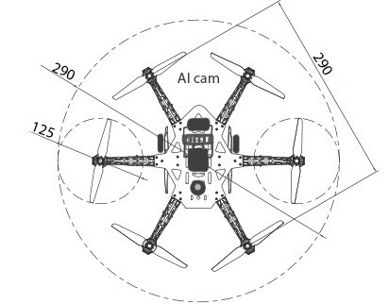
Robot Visualization -3D Diagram/Sketch
Flight Controller
Master
Compass
IR Sensors

Slide 7
Architecture
Radio RX
AI Camera 1
Compass
AI Camera 2
Master controller
STM32F103C8
(32-bit)
IR (Left)
IR (Right)
Flight Controller
32-bit
Robot gripper
Slave A category
M1
M1
M1
Slave B category
M1
M1
M1
M1
M1
M2
M3
M5
M1
M4
M6
Master category
Motor category

Slide 8
Architecture(Core)
STM32F103C8T6
32-bit ARM µ-controller
IR Sensors
Analog
--ADC1
--ADC2
12-bit FPU
PixyCam-1
PixyCam-2
--I2C1
--I2C2
NVIC Global Interrupt
________
Cortex M3 CPU
Compass
UART
TIM1-CH1
TIM1-CH2
TIM1-CH3
TIM1-CH4
TIM2-CH1
TIM2-CH2
Flight Controller
Radio Rx serial
Servo Claw Motor

Slide 9
Brief on Programming Module
Q. What programming language will be used?
+ C language
+ Python language
Q. What all software modules will be built?
+ Mission training utility (Python & C)
+ Master firmware PID loops (3)
+ AI for going through gates
+ GUI for camera feed

Slide 10
Execution Plan
With the idea on paper, we proceed in the following way:
Simulate the assembled hexacopter physics on pre-available platforms like VelociDrone.
Test separately the standalone modules used for desired functioning.
Calibrate the AI-Camera feedback for precise detection of objects, here ‘gates’.
After successful simulation/testing, go on to fabricate/assemble the modules & the drone itself.
Calibrate the modules & sensors used for precise function through PID.
Test the prototype in different environmental scenarios.
Test the MVP (Minimal Viable Product) in a self-made arena, simulating the needs of the actual scenario.

Slide 11
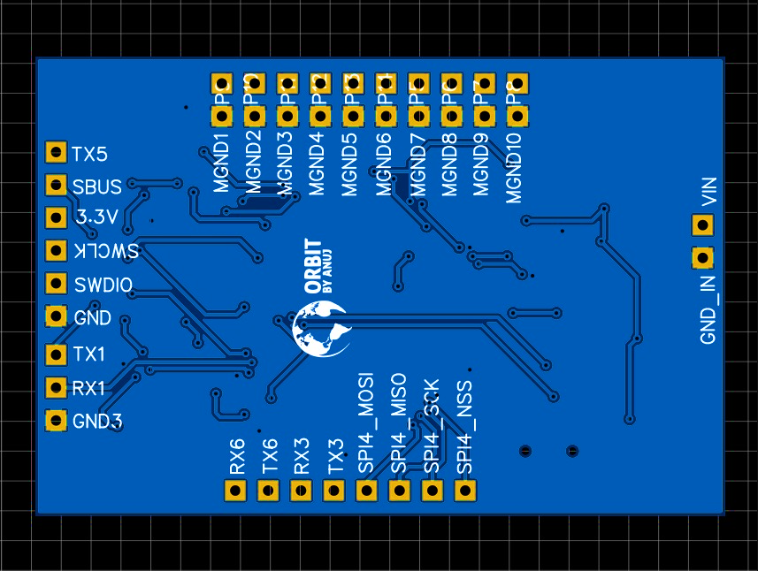
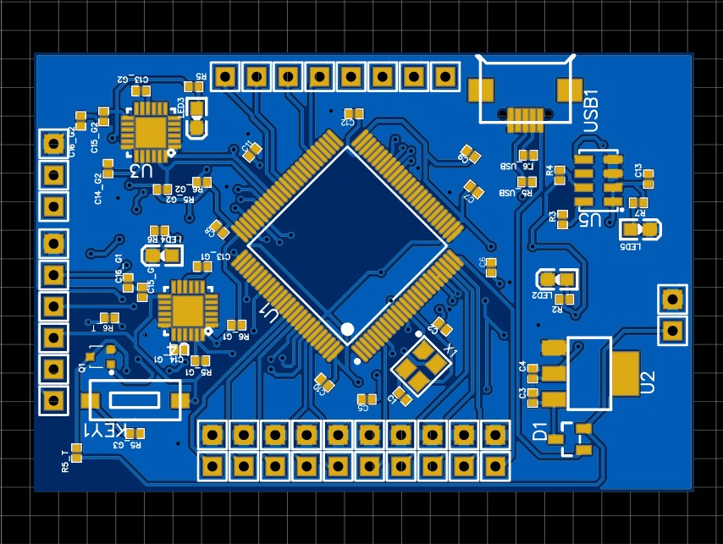
Extra: Our own Flight-controller
We take this opportunity to introduce teammate Pravesh’s hard-work and expertise in the making of our own Flight-controller – “ORBIT”
( Repository: https://github.com/Elvez/STM32F746-Flight-Controller )
ORBIT - Rear
ORBIT - Front

Slide 12
Orbit: Future Production Plan
(continued…)
With Orbit, we aim to make the mass production of utility-drones cheaper and efficient in India (and maybe abroad).
We wish to keep our project open-source for more widespread & creative development(s).
The cost of a typical market-available DJI Naza flight controller ranges somewhere between ₹5000/- to ₹15000/- but our flight controller costs merely ₹30/- for PCB fabrication + ₹1000/- for all modules attached to it. Increasing module quality would result in a slight increase of the total cost.
Orbit has its own firmware plus it can also support other common firmwares like ArduPilot, Betaflight, Cleanflight and iNav.
( Repository: https://github.com/Elvez/STM32F746-Flight-Controller )

Slide 13



